Slide 1
Biosimilars
APPHON
Bruce Colwell
Nov, 2023
No more double talk

Slide 2
Disclosures
I have been involved in discussions of Biosimilars since they were called subsequent entry biologics.
I have been involved in producing education material for pCOBI , CAPhO and CAMO as well as Pfizer
I have given talks and reimbursed by Amgen, Pfizer, Roche and Apobiologix.
These are companies that make either biologicals and/or biosimilars or both
I have been involved in advisory boards for the following companies in the last three years: Amgen, Fusion, Janssen, Pfizer, Roche and Viatris

Slide 3
Learning Objectives
Define Biological and Biosimilar medications
Describe how these medications are comparable but have inherent variability
Understand the regulatory approval process for these drugs
Understand what and how extrapolation works for these drugs
Describe the implications in your clinical practice terms such as
Switching, extrapolation and pharmacovigilance

Slide 4
Are these all Ducks ? Are they identical, biologicals, generic, biosimilars?

Slide 5
Outline
Define Biologicals and Biosimilars
Canadian Biological Regulatory Approval Pathways
Achieving Biosimilarity
Confidence in Biosimilars
Interchangability and switching
Naming
Local environment
Summary

Slide 6
Biologicals
Biologicals are complex protein molecules that are made in a living organism or system as opposed to through a chemical process.
They are much larger and much more complex than most manufactured drugs
As they are grown, they are molecules that are never absolutely identical (although the identical amino acid sequence) and thus cannot be perfectly duplicated ( like no apple on an apple tree will be identical )
Represent a significant amount of drug spending especially in Oncology

Slide 7
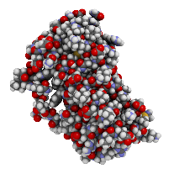
Biologics Are Larger and More Complex ^{10,11}
SMALL MOLECULE
BIOLOGIC
HIGHLY COMPLEX BIOLOGIC
Aspirin
180 Da
Filgrastim
18,880 Da
Immunoglobulin
150,000 Da
Bike
~ 20lbs
Car
~ 3,000lbs
Business Jet
~ 30,000lbs
^{10.} Haag et Krattiger. The Emergence of Biosimilars: How are they Different from Generics and What are the Implications for Marketing? Presented at: European Pharmaceutical Market Research Association Meeting; June 29, 2011. ^{11.} Schellekens H. Biosimilar therapeutics - what do we need to consider? NDT Plus. 2009; 2(suppl 1) 127-136.
Notes:
Another way to show the difference between biologics (large molecules) and chemical drugs (small molecules) is to use an analogy of comparing a bike to a plane
Imagine how many parts are needed to construct a bike, how difficult it may be and how long it might take you.
Now do the same in building a plane. Clearly there is no comparison in complexity
Using drugs as the examples
Aspirin, a common chemical drug, is like a bike – easy to produce and easy to reproduce.
A large IgG antibody is about 1000 times bigger – very complex.
The So What?
Increased manufacturing complexity impacts:
Cost to produce
Time to develop
Ability to duplicate/batch consistency
The need for continuous process improvement
Affects delivery system – can’t ingest proteins – they will be metabolized and therefore must be injected

Slide 8
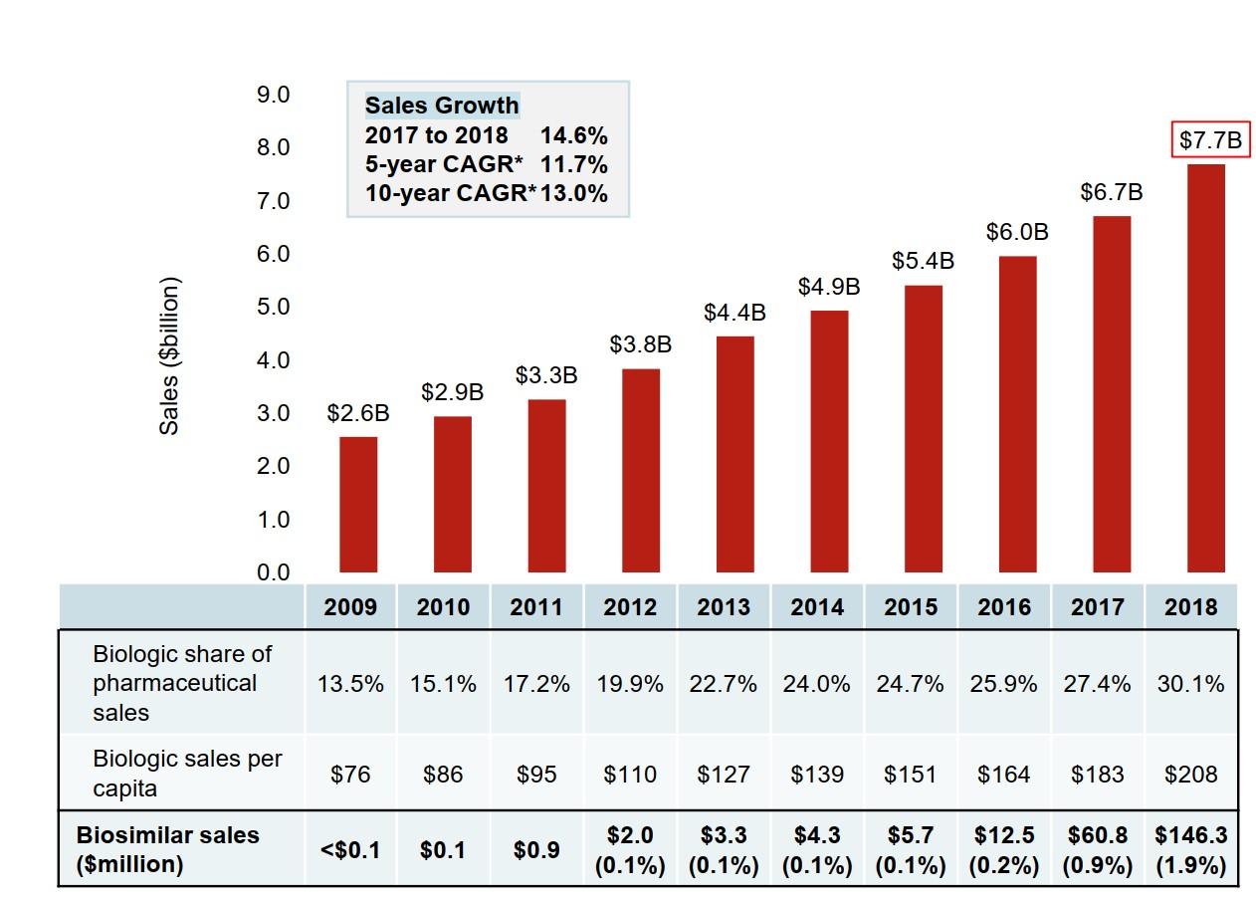
Sales of biologic medicines in Canada, 2009 to 2018 Figure description
Note: Includes all prescription biologics and insulin biologics sold in Canada as of 2018. * CAGR, compound annual growth rate. Data source: IQVIA MIDAS® Database, prescription retail and hospital markets, 2018. All rights reserved.
Canada is third highest per capita costs with OECD average $135

Slide 9
2022-2023
2022 total pharmaceutical market is now 83.08B and approximately 40% is biologicals
The top selling 10 drugs worldwide in 2022 include 7 biologicals of which 2 are checkpoint inhibitors drugs and 2 are COVID -19 vaccines

Slide 10
Biosimilars
Biosimilars are drugs made by competing pharmaceutical companies where the product is reverse engineered to be as “similar” as the originator.
Biologicals are not identical molecules so biosimilars cannot be the same and therefore they cannot be generics.
They must prove they are as close to the originator drug such that there is no meaningful difference using the reference biologic drug information.

Slide 11
Rio Olympics- womans marathon
German Twins tied for 82nd
Estonia Triplets- 97th, 114th, DNF
Which country was disappointed in their athletes?

Slide 12
Regular drug and a generic drug
Known molecular structure that can easily be duplicated.
Once patent protection has ended another company can start making the same drug. To prove it is the same they give it to usually well volunteers and measure the levels of drug in the body to ensure the drug is adsorbed as well. (Pharmacokinetics)
Must be found to be pharmaceutically equivalent and bioequivalent (90% of the CI of the AUC must fall within 80% to 125% of the innovator drug)
Once proven then the generic can be substituted for any indication that the drug has been approved for.

Slide 13
Exceptions
If patient does not adsorb drug the same way as the tested population
Ex absorption of cream in a patient with psoriasis
Imatinib mesylate in GIST as GI tract has tumor on it altering absorption
The inactive ingredients are not acceptable
Patient has allergy to filler compound

Slide 14
Problems
Does not measure activity just the drug level
Measurement of generic may measure non active part of molecule which could be altered during absorption
Lack of ongoing policing of drug once accepted
Example of generic producing empty capsules

Slide 15
Regulation of Biosimilars¹⁴
Sponsors filing for biosimilar approvals are required to file a New Drug Submission
Health Canada requires that for qualification as a biosimilar, the following criteria are met:
a suitable reference biologic drug exists
the product can be well characterized by a set of modern analytical methods; and
the biosimilar, through extensive characterization and analysis, can be judged similar to the reference biologic drug by meeting an appropriate set of pre-determined criteria.
^{14.} Guidance Document-Information and Submission Requirements for Biosimilar Biologic Drugs, 2016-11-14. http://www.hc-sc.gc.ca/dhp-mps/alt_formats/pdf/brgtherap/applic-demande/guides/seb-pbu/seb-pbu-2016-eng.pdf.
Notes:
More information for the presenter
What is a suitable reference biologic drug?
was originally authorized for sale based on a complete data package
has significant safety and efficacy data accumulated such that the demonstration of similarity will bring into relevance a substantial body of reliable data

Slide 16
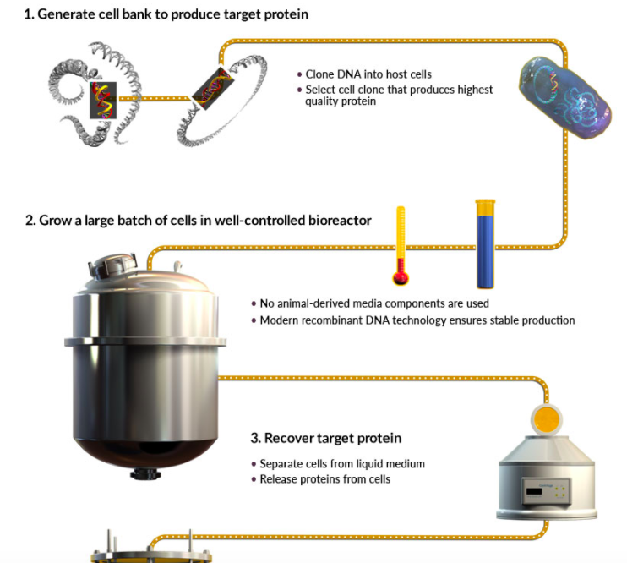
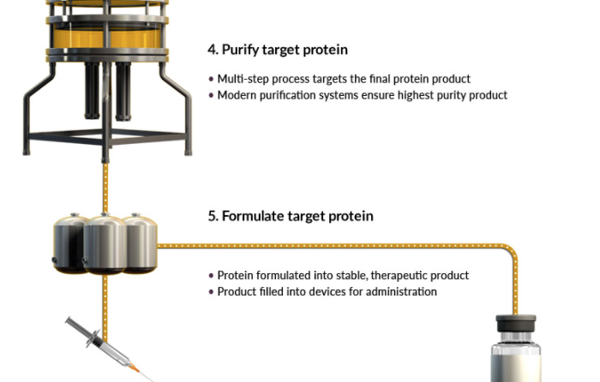
Biologics Manufacturing Process²⁴
Different process, highly similar product, no clinically meaningful differences
^{24.} Manufacturing, accessed October 11, 2017, <http://www.apobiologix.com/manufacturing/default.asp>
Notes:
The clone is designed by using the amino acid sequence of the originator product, and is then translated into suitable genetic code and inserted into the host cell. Mammalian cells (CHO, PERC6, etc) are used when glycosylation of the protein is required. In this scenario, the vector is integrated into the host genome, where it is translated into protein that undergoes post translational modifications (PTM) and is then secreted into the media. The product is then recovered from the supernatant.
Filgrastim does not contain PTMs, and is expressed on a plasmid that is replicating within E.coli. The protein is not secreted, and must go through a process to release it from the cells prior to being purified.
Cells are grown in a bioreactor, where they continually express the protein of interest. Temperature, dissolved oxygen, pH, cell density & viability etc. must be closely monitored to ensure desired product quality.

Slide 17
High Quality and Consistent Biosimilars Produced
Establish a well-defined manufacturing process with its associated process controls. This is highly protected by the company.
Each batch produced will be tested as per pre-approved specifications to ensure it meets quality standards.
Any process changes will be pre-approved by Health Canada prior to the implementation to ensure no impact on product quality
Notes:
For each batch produced and released for commercial use, a panel of analytics are used to demonstrate and ensure quality from batch to batch. These validated methods have been reviewed and approved by Health Canada.

Slide 18
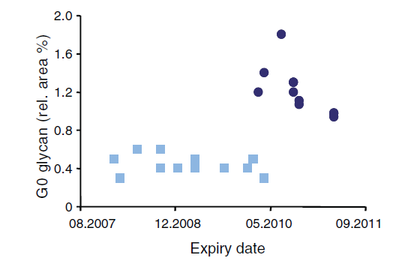
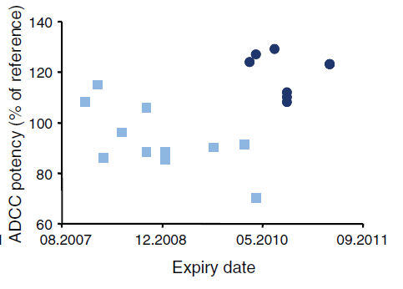
All Biologics Vary From Batch to Batch¹²
Variability is normal and anticipated especially for glycosylated proteins
No batch of any biologic is “identical” to any other batch
Characterization of Commercial Batches
Rituxan / Mabthera (rituximab)
Shift in Glycosylation Profile and ADCC Potency
ADCC=antibody-dependent cell cytotoxicity
Post-change
Post-change
Pre-change
Pre-change
Differences/shift in glycosylation pattern results in different potency in cell based assays
Product label remained unchanged - indicating difference was not determined to be clinically meaningful
^{12.} Shiestl M, et al. Acceptable changes in quality attributes of glycosylated biopharmaceuticals. Nature Biotechnology. 2011; 29(4): 310-312. Copyright 2011. <https://www.nature.com/nbt/journal/v29/n4/full/nbt.1839.html>
Notes:
Starting with batch consistency, it is important to understand that all biologics vary from batch to batch. Using Rituxan as the example, this graph shows that over time, different batches of Rituxan have different levels of potency. Not clinically meaningful differences, but differences.
Why this is important is because there is a lot of talk about how biosimilars may slightly different compared to reference biologics. Originator biologics differ from their own original batches. Each batch of a biologic product is a biosimilar of their previous batches.

Slide 19
Similar, same or close enough

Slide 20
Biosimilars Development Differs from Biologics
Originator Development
Clinical Studies
(safety, efficacy, immunogenicity)
Clinical Pharmacology
(PK/PD)
In Vivo Studies
(Non-clinical)
In Vitro Studies
(Analytical characterization)
Biosimilar Development
Adapted from Gnant, M– Biosimilars Symposium – ESMO 2016, Copenhagen
Notes:
Achieving approval for a biosimilar follows a stepwise approach to demonstrating biosimilarity, a pathway that is the inverse of the originator biologic.
Both developments begin with clone development and expression, which is then followed by analytical characterization.
The analytical characterization is extensive in the development of a biosimilar to definitively characterize protein structure and post translational modifications (PTMs).
Nonclinical studies follow, demonstrating similar binding in vitro and cell based affects in vivo, generally with animal studies.
For Biosimilars, clinical pharmacology studies are performed to identify similar PK/PD profiles of the originator and biosimilar. Finally, for biosimilars, a relatively small scale clinical study is performed to demonstrate comparable efficacy and immunogenicity, typically in a single indication.

Slide 22
Next steps
Once clearly established structural similarity established must then do PK/PD studies looking at a similar population where the disease state of the tested population does not alter the parameters.
Take into account half life, linearity of PK parameters, any endogenous sources and variation of such, disease treated, route of administration and indications
Must also do studies looking at immunogenicity

Slide 23
Clinical trial evidence
Not required for generics but almost always for biosimilars .
Must have a comparative clinical trial that is adequately sensitive to rule out a meaningful difference taking into account mechanism of action and population.
E.g. Trastuzumab biosimilars studies in neoadjuvant population
May need to do in more than one sensitive patient. Infliximab studies done in both rheumatoid and gastroenterology indications
Equivalence trials are preferred but could use non inferiority trial.
E.g. The first biosimilar filgrastim brands in the EU required Phase III equivalence trials for approval. More recent approvals only require non-comparative safety studies.
This is due to a highly sensitive endpoint, duration of severe neutropenia (DSN), that could be measured.

Slide 24
Equivalence Studies
- M
0
+ M
-Δ Non-inferiority margin
+Δ Non-inferiority margin
Inferior Treatment
Superior Treatment
Equivalence
Superiority
Non-inferiority
Difference in effect of treatment
Notes:
Equivalence testing is a 2 sided statistical test to determine if the entire 90% CI of the endpoint evaluated falls within a pre determined margin. A result that fits within the equivalence margin is neither inferior or superior to the referent treatment.

Slide 25
Clinical trials examples
G-CSF tested breast cancer patients to see if duration of nadir occurred for the same length of time. Compared to historical controls of patients on different type of chemotherapy and a mixture of metastatic and adjuvant
Bevacizumab (Avastin) randomized between originator drug and Biosimilar in patients with lung cancer not colorectal cancer which we normally use this drug for.
Health Canada felt that this data along with the other comparable data showing that is was as close as possible to the originator that it was approved.

Slide 26
Are Biosimilars New?
Biosimilars have been approved internationally since 2005.
At that time, Australia approved a biosimilar for human growth hormone.
Europe has 10+ years of experience with biosimilars.
Over 54 biosimilars approved as of March 2019
Nearly 700 million patient days
US and Canada are catching up with the use of biosimilars.
Health Canada approved the first therapeutic oncology biosimilar in 2018.
Sept of 2023 37 biosimilars were on the market in the US
Generics and Biosimilars Initiative Online. Biosimilars approved in Europe. 2011 [updated 2018 December 14]. Available from: http://www.gabionline.net/Biosimilars/General/Biosimilars-approved-in-Europe
Clinic Practice
Extrapolation
Regulatory
Comparability
Variability
Production
Biosimilars
Biologics
Notes:
Biosimilars are not new.
Biosimilars have been approved internationally since 2005.
At that time, Australia approved a biosimilar for human growth hormone.
Europe has 10+ years of experience with biosimilars.
Over 54 biosimilars approved as of March 2019
Nearly 700 million patient days
US and Canada are catching up with the use of biosimilars.
Health Canada approved the first therapeutic oncology biosimilar in 2018.

Slide 27
Necessary for the Approval of Each Indication for a Biosimilar
A biosimilar is not required to prove its efficacy in each indication as it was already established by the reference biologic product
A biosimilar can be approved for all or some of the reference product’s indications based on the existing trials conducted
Sufficient scientific justification for authorization of the biosimilar in each indication is necessary
It is a regulatory decision on a case-by-case basis
Notes:
Approval of indications is based on a totality of evidence
There is no scientific justification for requiring clinical testing of a biosimilar for each indication for which the reference product is approved. To do so would simply drive up costs for no reason, thus denying patients and the healthcare system the savings that biosimilars would otherwise bring.

Slide 28
Is this enough
If the molecule is the same ( as close as possible) and level of drug the same and trial show equivalence and it costs less we should use it
well
Better proof is that we have been using biosimilars for years as every time there is a change in the process of making the drug it is a biosimilar from the same company.

Slide 29
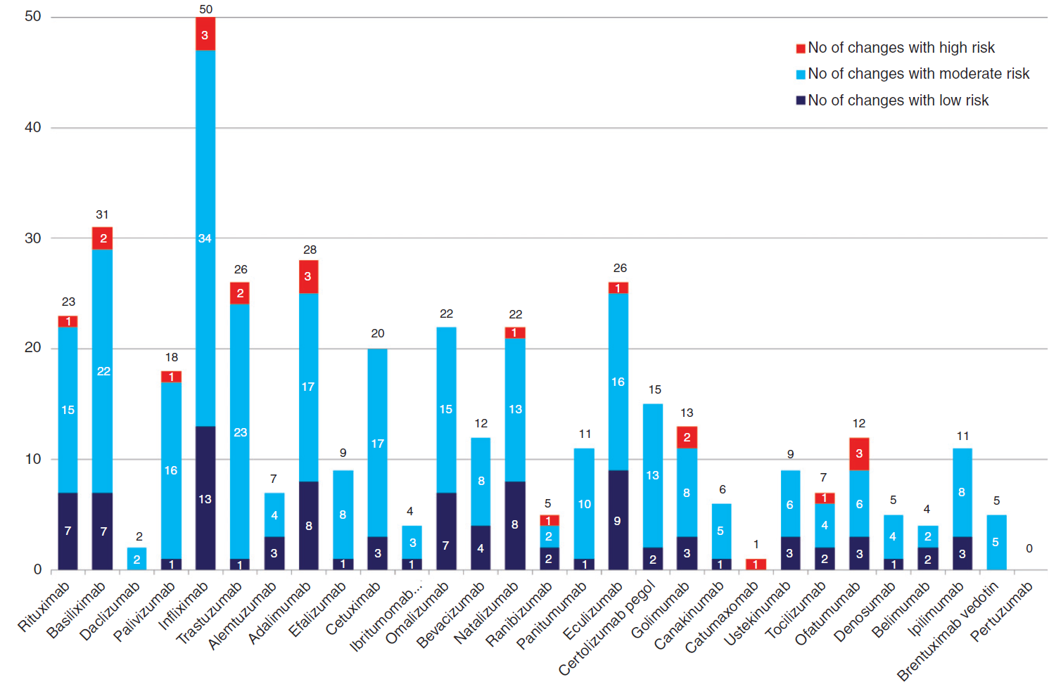
Changes to production processes since licensing?
Vezér B, Zrubka Z et al; CMRO, 2016, 32:829-834
Notes:
Each of these changes essentially put patients in a non-medical switch position as the changes are not made to improve the product (that would make it a new product with a new whole application and clinical trials) but to improve the company’s bottom line.

Slide 30
Interchangeability
Health Canada's authorization of a biosimilar is not a declaration of equivalence to the reference biologic drug²²
In Canada, the authority to declare two products interchangeable rests with each province and territory according to its own rules and regulations²²
^{22.} Fact Sheet: Biosimilars, Aug-3, 2017. https://www.canada.ca/content/dam/hc-sc/migration/hc-sc/dhp-mps/alt_formats/pdf/brgtherap/applic-demande/guides/biosimilars-biosimilaires-qa-qr-eng.pdf

Slide 31
Safety - Immunogenicity
Anti-drug antibody (ADA)
Human immune system has recognized the biologic medication as foreign
Develops immunity to the biologic medication
Immune system has antibodies circulating that can bind to the biologic medication
Neutralizing ADA (NADA)
Circulating antibodies neutralize the activity of the biologic medication
May reduce efficacy
May impact pharmacokinetics

Slide 32
Extrapolation
Refers to use of a biosimilar for indications where clinical studies not done.
Health Canada now uses the term “authorization of indications”
Looks at totality of evidence of similarity of structural, functional non-clinical and clinical data to make decision

Slide 33
Switching
Health Canada considers a well-controlled switch from the reference biologic drug to a biosimilar in an approved indication to be acceptable²³
Health Canada recommends that a decision to switch a patient being treated with a reference biologic drug to a biosimilar, or between any biologics, be made by the treating physician in consultation with the patient, and taking into account any policies of the relevant jurisdiction²³
In Nova Scotia we decided to grandfather patients on therapy but institute in all new starts. If you switched mid cycle and patient on next scan progressed then pt would blame the change
Provinces that mandate change are much more successful than making biosimilars available.
^{23.} Biosimilars: State of Clinical and Regulatory Science, Agnes Klein, Jian Wang, Brian Feagan, Mark Omoto, J Pharm Pharm Sci (www.cspsCanada.org), 20, 332-348, 2017

Slide 34
Post-Notice of Compliance (NOC)
As with all approved medications, biosimilars must track the safety of their product
Pharmacovigilence should be maintained as per the reference biologic.
Companies may also apply for more indications post-NOC
Safety comprises medication-specific safety items as well as immunogenicity
E.g trastuzumab and LVEF changes
Notes:
https://www.canada.ca/en/health-canada/services/drugs-health-products/biologics-radiopharmaceuticals-genetic-therapies/applications-submissions/guidance-documents/information-submission-requirements-biosimilar-biologic-drugs-1.html#per

Slide 35
Pharmacovigilance
In 2012 53,000 reports to MedEffect Canada were made.
Estimated only 1 to 10% of all adverse events
4% of the drugs approved in a 5 yr period eventually taken off the market.
Biosimilars follow the same rules as any other new drug in Canada but must submit a risk management plan including how to distinguish adverse events associated with their drug
Vanessa law passed in December 2019 which makes it mandatory to report any serious adverse drug reaction or medical device incident to Health Canada. A LMS course is available and Mandatory for all clinical staff to complete in 3 months

Slide 36
Vanessa’s Law
http://intra.nshealth.ca/patientsafety/VanessasLaw/Health%20Canada%20Vanessa's%20Law%20presentation%202019-12-05.pdf
http://intra.nshealth.ca/patientsafety/SitePages/vanessaslaw.aspx
The HCP who recognizes the incident must report it on SIMS

Slide 37
naming
How do you name the drug was decided in Canada only in the 2020.
The name will be the drug name followed by the generic so you could
trastuzumab- herceptin
trastuzumab-ogiveri
trastuzumab-trasmera.
The name length can be problems with pharmacies especially with antibody drug conjugates and subcutaneous formulations

Slide 38
Nova Scotia
There are several in use in Oncology trastuzumab, rituximab, pegfilgrastim and filgrastim.
Pertuzumab packages the Trastuzumab with it so we use the originator as it is free.
There are some provinces using two and some using different ones for different indications but most picked one.
Drug shortage problems have lead us to coordinate with other provinces so we use different drugs.
Length of production could lead to problems with drug shortage in future.
Tendering process has not been established.

Slide 39
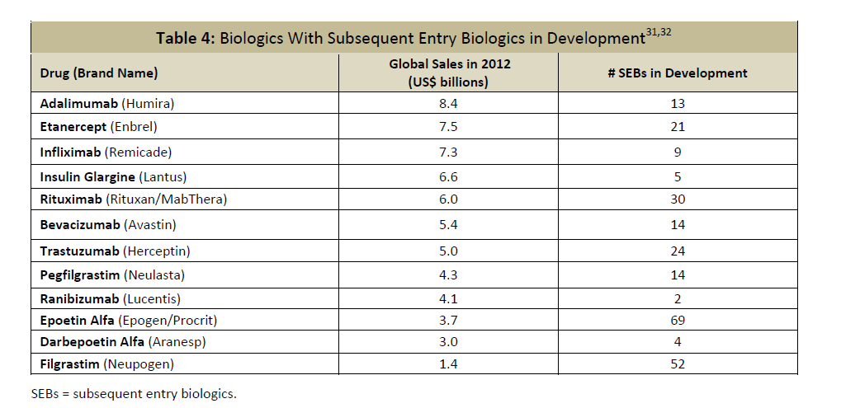
What is coming

Slide 40
Summary
Biosimilars are examined for all attributes that the originator drug does when it undergoes a manufacturer change plus a clinical study.
It is analysed much more than a generic drug.
Interchangeability is a provincial jurisdiction that is you examine the evidence should rely on differences such as price , manufacturer reliability, and other non clinical values as clinically they are as much the same as possible.

Slide 41
objective
Are all these ducks ? Generic, Biosimilars other

Slide 42
Questions

Slide 43
Biologic Drug Spending
^{3.} IMS Canada Data MAT June 2017
Notes:
Let’s take a closer look at Canada, spending on biologics reached $5.2 billion in 2017, a 300% increase from 2007.

